Slide 1
Grow Your Own Oyster Mushrooms
An introduction to log culture
Dr. Tera Lewandowski
Jess Lewandowski

Slide 2
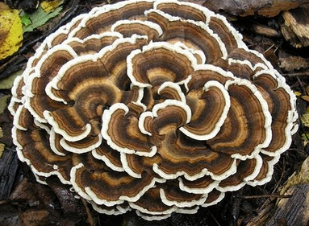
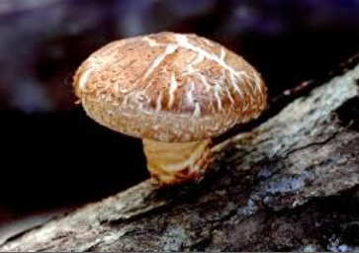
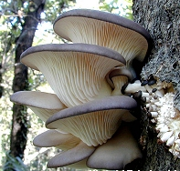
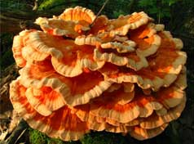
What is a Mushroom?
Wood decomposing mushrooms are a saprobic type of fungi that utilize carbon, nitrogen, and other elements from dead wood in order to grow.
Mushrooms grow vegetatively through the spread of mycelium, which can be thought of as a “web of roots” in the growth medium
The mushrooms that we see are only the fruiting body of the fungi, similar to a flower. These produce spores, which are analogous to seeds.
They do not need light to decompose wood, although most are phototropic, meaning light is necessary to induce fruiting

Slide 3
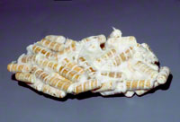
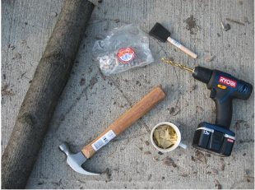
Supplies
Mushroom Plugs
Fungi Perfecti (www.fungi.com)
Aloha Medicinals (www.alohaculturebank.com)
Field and Forest (www.fieldforest.net)
Measuring tape or jig
Drill
5/16” Drill Bits
Mallet
Sealing Wax
Heat source to melt wax
Paint Brushes
Logs

Slide 4
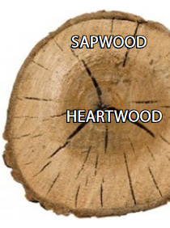
Selecting the Wood
The species of wood you select will depend on the species of mushroom you are growing
Plug Spawn grows on recently cut or fallen logs. Milled lumber, rotted wood or trees that have been down for longer than 6 months are not suitable.
Bark should be intact. Damaged bark allows for greater change of invasion by “weed” fungi and increased moisture loss
Logs should be cut to lengths of 3–4 feet, and are best if they do not exceed approximately 8 inches in diameter.

Slide 5
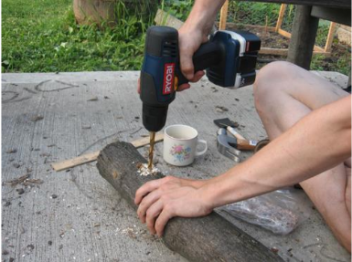
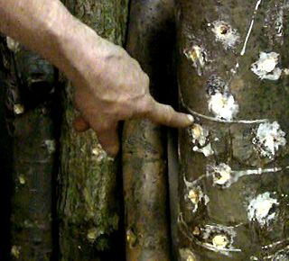
Drilling the Holes
Drill 40 holes / log
Holes should be ¾” Deep; mark drill bits to appropriate depth
Holes should be in a diamond pattern
5 rows, 8 holes/row
Staggered placement

Slide 6
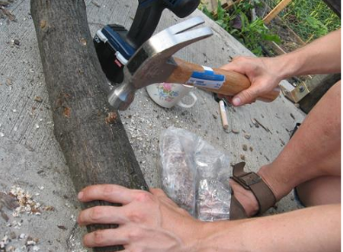
Plugging the Logs
Use hammers or mallets to insert 1 plug into each drilled hole

Slide 7
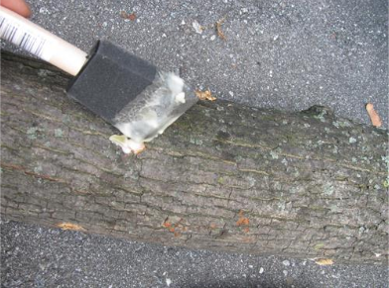
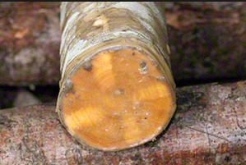
Sealing the Logs
Logs are sealed with wax to prevent “weed” fungi colonization and moisture loss
Use paintbrushes to seal inoculation holes and ends of logs.
If other significant tears in the bark are present, seal these too

Slide 8
Storing the Logs: Incubation
6 to 12 month period where fungus fully colonizes the wood
If possible, logs should be kept off the ground to reduce “weed” fungal colonization
Keep logs moist during this period. Watering once a week is a good practice. You do not need to add water if they are already getting heavy water
Stop watering during freezing temperatures
Keeping logs in the shade can help to keep moisture high

Slide 9
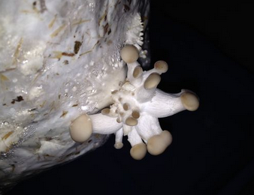
Fruiting: Initiating the Logs
“Shocking” the mycelium into fruiting
In nature, this is done with a change in environmental factors such as temperature or moisture for wood decomposing fungi
Can use either method to induce fruiting, the easiest method is soaking the log in a tub
Fruiting orientation can be vertical or horizontal
Once mushrooms begin “pinning”, anticipate a harvest within 1 week.

Slide 10
Pearl Oyster Mushroom
Genus Species: Pleurotus ostreatus
The most common edible mushroom found on hardwoods
Favored Wood: Alder, Maple, Elm, Oak, Birch, Beech, Ash, Mulberry, Sweetgum. Cottonwood, Poplar, Willow, Basswood, Aspen are also suitable but break down quickly
Incubation orientation: Horizontal
Preferred Fruiting Temperature: 50-70 F
Fruiting Season: Spring, Fall
Time Till Fruiting: 6 months – 2 years
Length of Maturation: Once fruiting begins, mushrooms are ready to eat within 1 week

Slide 11
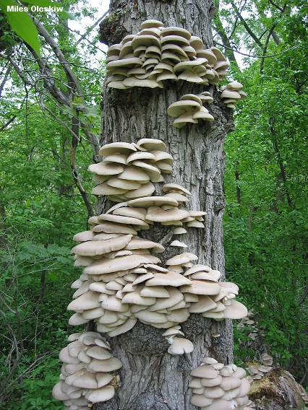
Pearl Oyster Identification
Ecology: Saprobic; growing in shelf-like clusters on dead logs and living trees; causing a white rot; fall, winter, and early spring; common; widely distributed in North America.
Cap: 4-15 cm; convex, becoming flat or somewhat depressed; kidney-shaped to fan-shaped, or nearly circular if growing on the tops of logs; the margin inrolled when young, later wavy, never lined.
Gills: Running down the stem; close; whitish or with a gray tinge, sometimes yellowish in age.
Stem: Usually rudimentary and lateral (or absent) when the mushroom is growing from the side of a log or tree. When it grows on the tops of logs or branches, or at an angle, however, it may develop a substantial and thick stem that is dry and slightly hairy near the base.
Spore Color: White
Flesh: Thick; white.

Slide 12
References
Tera Lewandowski: tera.lewandowski@gmail.com
The Mushroom Expert: www.Mushroomexpert.com
Fungi Perfecti: www.fungi.com
Best Management Practices for Log-Based Shiitake Cultivation in the Northeastern United States: https://www.uvm.edu/~susagctr/resources/ShiitakeGuide.pdf
Growing Mushrooms on Logs – a step-by-step Guide: http://www.alohaculturebank.com/growing-mushrooms-on-logs.pdf

